Slide 1
Lesson objective
Title: Multiplication and division
Aim – be able to:
Use written strategies to multiply and divide using fractions
Operations with mixed numbers and improper fractions
Plan:
Review addition and subtraction
Multiplying
Dividing
Need whiteboards.

Slide 2
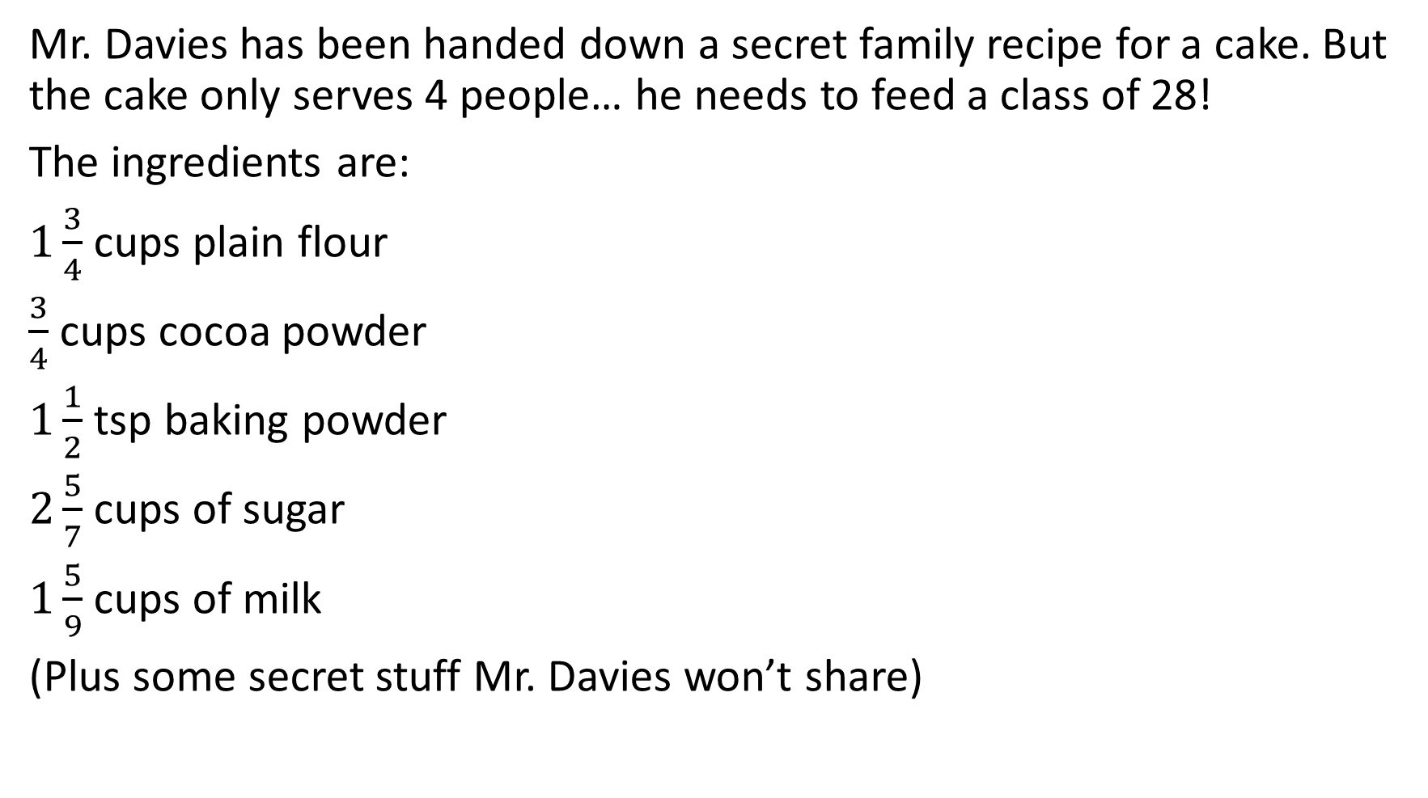
Mr. Davies Secret recipe
Mr. Davies has been handed down a secret family recipe for a cake. But the cake only serves 4 people… he needs to feed a class of 28!
The ingredients are:
$1\frac{3}{4}$ cups plain flour
$\frac{3}{4}$ cups cocoa powder
$1\frac{1}{2}$ tsp baking powder
$2\frac{5}{7}$ cups of sugar
$1\frac{5}{9}$ cups of milk
(Plus some secret stuff Mr. Davies won’t share)
How much of each ingredient does Mr. Davies actually need to feed the whole class?
How much would he need if he wanted to make a small 1 person cake?

Slide 3
Why equivalent fractions?
Addition and subtraction of fractions _____ a common ___________
What do we need to add and subtract fraction?

Slide 4
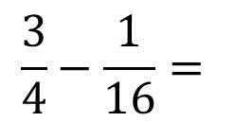
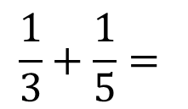
Lowest common denominator, shared factors
List the multiples of each denominator.
Circle the smallest multiple of BOTH numbers (matching multiples).
The LCM is the new denominator for both fractions.
Multiply the numerator by the same number as the original denominator.
3 and 5
4 and 16
$$\frac{1}{3}+\frac{1}{5}=$$
$$\frac{3}{4}−\frac{1}{16}=$$
 | 4 | 16
Multiples | 8 | 32
 | 12 | 48
 | 16 | 64
 | 20 | 80
 | 24
 | 28
 | 3 | 5
Multiples | 6 | 10
 | 9 | 15
 | 12 | 20
 | 15 | 25
 | 18 | 30

Slide 5
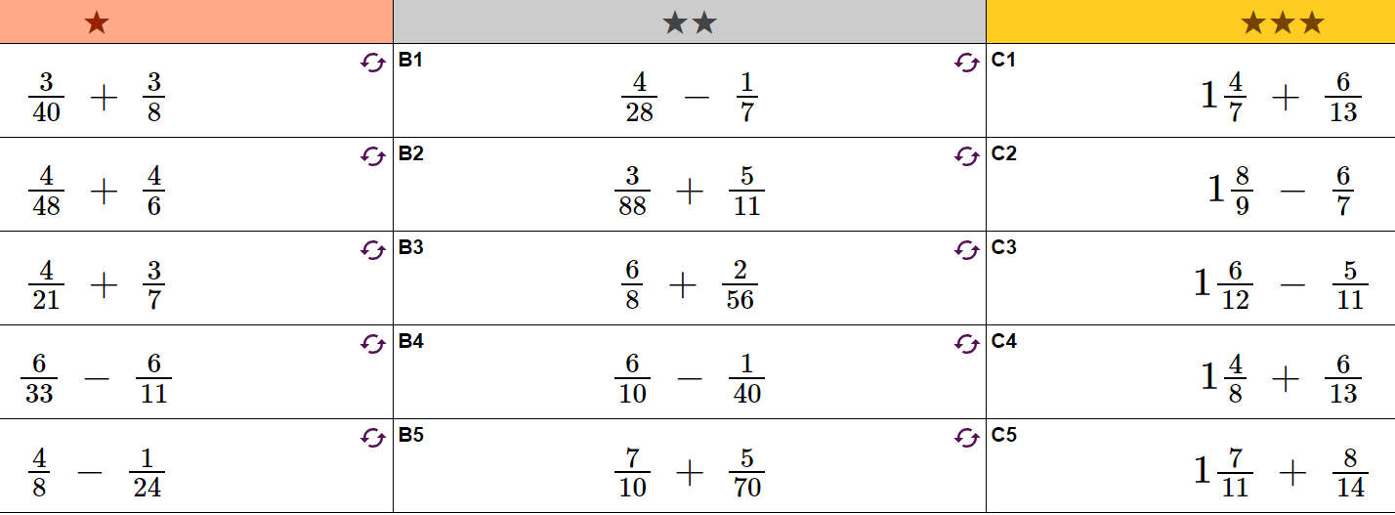

Slide 6
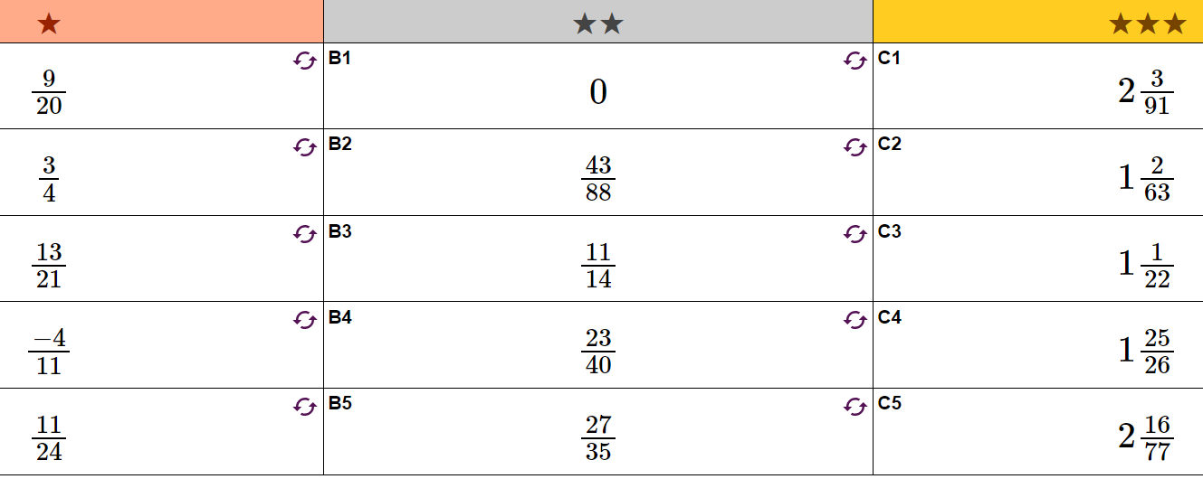

Slide 7

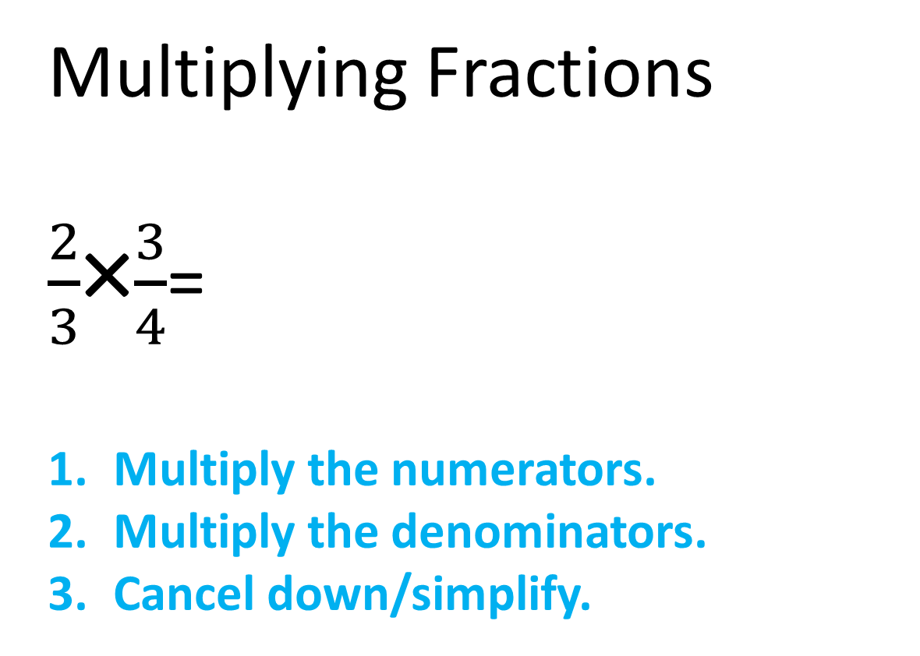
Multiplying Fractions
$\frac{2}{3}$×$\frac{3}{4}$=
Multiply the numerators.
Multiply the denominators.
Cancel down/simplify.
2 × 3 6
$$\frac{1}{2}$$
=
=
3 × 4 12

Slide 8


Examples
Multiply the numerators.
Multiply the denominators.
Cancel down/simplify.
I do:
$\frac{3}{4}×\frac{7}{8}=$
$\frac{5}{6}×\frac{1}{2}=$
$\frac{2}{5}×7=$
We do:
$\frac{2}{3}×\frac{3}{4}=$
$\frac{11}{7}×\frac{3}{4}=$
$\frac{9}{2}×3=$

Slide 9


You do – Whiteboards
Multiply the numerators.
Multiply the denominators.
Cancel down/simplify.
Challenge:
$$1\frac{3}{4}×\frac{2}{7}=$$
$$2\frac{3}{7}×4\frac{1}{2}=$$
$\frac{5}{6}×\frac{2}{3}=$
$\frac{7}{8}×\frac{1}{2}=$
$\frac{11}{2}×\frac{3}{6}=$

Slide 10




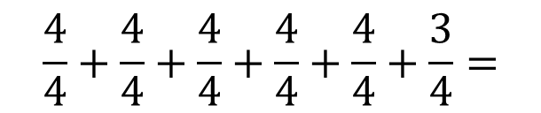

Mixed fraction multiplication
Partitioning method.
Improper fractions:
$2\frac{3}{7}=$
$5\frac{3}{4}=$
Whiteboards – you try
Convert to improper fractions:
$2\frac{3}{5}=$
$1\frac{5}{12}=$
$5\frac{1}{2}=$
$$\frac{7}{7}+\frac{7}{7}+\frac{3}{7}=$$
$$\frac{17}{7}$$
$$\frac{4}{4}+\frac{4}{4}+\frac{4}{4}+\frac{4}{4}+\frac{4}{4}+\frac{3}{4}=$$
$$\frac{23}{4}$$

Slide 11

Convert to improper fraction
$$\frac{\left(whole \# ×denominator\right)+numerator}{Original denominator }$$

Slide 12


Whiteboards – convert then multiply
$$\frac{\left(whole \# ×denominator\right)+numerator}{Original denominator }$$
$1\frac{2}{3}×4\frac{1}{2}=$
$3\frac{2}{5}×1\frac{2}{3}=$
$7\frac{1}{2}×\frac{4}{5}=$

Slide 13






Dividing Fractions
$\frac{3}{4}$ ÷ $\frac{1}{3}$
$\frac{3}{4}$
$$\frac{3}{1}$$
=$2\frac{1}{4}$
=
÷
$$\frac{1}{3}$$
= $\frac{9}{4}$
×
Turn the dividing fraction upside down and change ÷ to ×.
Multiply numerators and denominators.
If necessary cancel down and change to a mixed number.

Slide 14


Examples
Turn the dividing fraction upside down and change ÷ to ×.
Multiply numerators and denominators.
If necessary cancel down and change to a mixed number.
I do:
$\frac{3}{4}÷\frac{2}{3}=$
$\frac{5}{6}÷\frac{4}{6}=$
$\frac{2}{5}÷\frac{7}{2}=$
We do:
$\frac{2}{3}÷\frac{1}{2}=$
$\frac{11}{7}÷\frac{4}{5}=$
$\frac{9}{2}÷3=$

Slide 15


You do – Whiteboards
Turn the dividing fraction upside down and change ÷ to ×.
Multiply numerators and denominators.
If necessary cancel down and change to a mixed number.
Challenge:
$$1\frac{3}{4}÷\frac{2}{7}=$$
$$2\frac{3}{7}÷4\frac{1}{2}=$$
$\frac{9}{12}÷\frac{3}{5}=$
$\frac{7}{8}÷\frac{1}{2}=$
$\frac{11}{2}÷\frac{3}{6}=$

Slide 16
Mr. Davies Secret recipe
Mr. Davies has been handed down a secret family recipe for a cake. But the cake only serves 4 people… he needs to feed a class of 28!
The ingredients are:
$1\frac{3}{4}$ cups plain flour
$\frac{3}{4}$ cups cocoa powder
$1\frac{1}{2}$ tsp baking powder
$2\frac{5}{7}$ cups of sugar
$1\frac{5}{9}$ cups of milk
(Plus some secret stuff Mr. Davies won’t share)
How much of each ingredient does Mr. Davies actually need to feed the whole class?
How much would he need if he wanted to make a small 1 person cake?

